Slide 1
The Network Layer – Part 2

Slide 2
Contents
IP Forwarding
Introduction to Routing
  Static Routing, Dynamic Routing
The Optimality Principle, Shortest Path Routing
Routing Algorithms:
  Flooding
  Distance Vector Routing, Link State Routing
  Hierarchical Routing
  Broadcast Routing, Multicast Routing

Slide 3
routing
daemon
route
command
netstat
command
routing table updates
from adjacent routers
UDP
TCP
ICMP
yes
ICMP
redirects
our packet(one of
our IP addresses or
broadcast address)?
no
forward datagram
(if forwarding enabled)
routing
table
IP output:
calculate next hop
router (if necessary)
source routing
process IP options
IP input queue
IP layer
Network interfaces
Processing done at the IP layer
Extracted from TCP/IP Illustrated, Volume 1, by W. Richard Stevens
Notes:
这图是说明IP协议的
上面的routing daemon：后台运行的进程，用来形成一个设备中的路由表的，是动态路由协议的软件
Route command：是route命令，可以修改路由表，（增删改查），静态配置（静态配置比动态级别高，转发时优先考虑静态）
静态配置：通过命令行
动态配置：通过动态路由协议
netstat command：
上面三个都是是用来配置、查找路由信息的模块

Slide 4
IP Forwarding
The IP layer has a routing table in memory that it searches each time it receives a datagram to send.
Each entry in the routing table contains the following info.:
  Destination IP address: host address or a network address
  IP address of a next-hop router, or the IP address of a directly connected network
  Flags: specifies the type of the Destination IP address, the type of next-hop router
  Specification of which network interface the datagram should be passed for transmission
Notes:
如果一条路由记录表示的是到某一个子网（或网络），那么目的地址填的是该网络的IP地址前缀
包的转发时逐跳的，在路由表里会确定下一跳的路由地址
Flag是说明路由项的信息
路由表中有这么一个信息：如果要把IP包从设备中转发，应该从设备的哪一个网卡中发送出去（可能会有多个网卡）

Slide 5
IP Forwarding
For a host:
  IP datagram is sent directly to the destination, if the destination is directly connected to the host(e.g., a point-to-point link) or on a shared network(e.g., Ethernet or token ring);
  Otherwise, the host sends the datagram to a default router.

Slide 6
IP Forwarding
IP Forwarding performs the following actions:
  Search the routing table for an entry that matches the complete destination IP address (matching network ID and host ID). Point-to-point links are found here, for example.
  Search the routing table for an entry that matches just the destination network ID. All the hosts on a local Ethernet, for example, are handled with a routing table entry of this type.
  Search the routing table for an entry labeled "default." If found, send the packet to the indicated next-hop router.
  If none of the steps works, the datagram is undeliverable.
Notes:
怎么转发IP包的：
1.找路由表里的路由记录，找和目的地址是吻合的；有两种情况：1.如果目的地址不是子网的，而是确定的IP地址（network ID and host ID）；2.如果目的地址不是确定的IP地址而是子网的IP地址的前缀（ONLY the destination network ID），这个时候选用唯一的确定的目的地址的路由记录来转发IP包
2.如果都是子网的前缀而不是确定的IP地址，这个时候选用子网范围小的那个路由
3.找不到，用default路由
4.没有default路由，就丢掉包

Slide 7
Internet
dest Enet = Enet of 140.252.1.4
dest IP = 192.48.96.9
next hop = 140.252.104.2 (default)
gateway
link
hdr
IP
hdr
.1.4
Ethernet, subnet 140.252.1
.1.183
netb
next hop = 140.252.1.4 (default)
modem
SLIP
IP
hdr
modem
dest IP = 192.48.96.9
next hop = 140.252.13.33 (default)
.1.29
bsdi
sun
next hop = 140.252.1.183 (default)
.13.35
.13.33
Ethernet, 140.252.13
link
hdr
IP
hdr
dest IP = 192.48.96.9
dest Enet = Enet of 140.252.13.33
Figure 3.4 Initial path of datagram from bsdi to ftp.uu.net(192.48.96.9)
Notes:
子网：
Gateway：路由器，负责把子网内产生的到外网的数据包发送出去
一上一下为两个子网，有两个主机netb和sun，通过串口连接起来，距离长的有Modem，在串口上的IP协议使用的是SLIP协议，这个是Unix系统的协议，
这两个子网都有IP地址的前缀，下面的即是140.252.13，上面的IP地址的前缀是140.2521（没错），主机bsdi的地址是140.252.13.35，sun主机的IP地址是140.252.13.33，两个口，一个是以太网，一个是串口，140.252.1.29是上面的网地址
下面的发送IP包，目的地址填成192.48.96.9，源地址是140.252.13.35，这个包要从gateway发送出去到外网，就逆时针走大半个圆到gateway
，通过3台机器的转发
Bsdi是通过查路由表知道数据包应该从gateway出去的（因为目的地址不是落在子网上），所以接收这个包的主机和bsdi不是直连的；所以下一跳地址应该是sun，140.252.13.33，所以bsdi要构造数据链路层的帧，这个帧的目的mac地址是sun的140.252.13.33这个网卡的mac地址，保证sun能接到这个包，不然收不到帧，帧里的IP包自然收不到= =，这个工作是在数据链路层做的，不是网络层做的
IP包所对应的下一跳的路由器的IP地址，即gateway的140.252.1.4，然后就发送给gateway

Slide 8
svr4% netstat -rn
Routing tables
Destination
Gateway
Flags
Refcnt
Use
interface
140.252.13.65
140.252.13.35
UGH
0
0
emd0
127.0.0.1
127.0.0.1
UH
1
0
lo0
default
140.252.13.33
UG
0
0
emd0
140.252.13.32
140.252.13.34
U
4
25043
emd0
U: The route is up.
G: The route is to a gateway (router). If this flag is not set, the destination is directly connected.
H: The route is to a host, that is, the destination is a complete host address. If this flag is not set, the route is to a network, and the destination is a network address: a net ID, or a combination of a net ID and a subnet ID.
D: The route was created by a redirect
M: The route was modified by a redirect
Notes:
第一行：表示非直连、destination是确定的IP地址的
第二条：是环回记录，不经网卡的
第三行：destination给出的不是主机地址而是子网地址
第四行：发送方和接收方是直连的

Slide 9
Routing —— Introduction
The routing algorithm is that part of the network layer software responsible for deciding which output line an incoming packet should be transmitted on.
  Routing: making the decision which routes to use
  Forwarding: handles each packet as it arrives, looking up the outgoing line to use for it in the routing tables
Certain properties are desirable in a routing algorithm:
  correctness, 正确
  simplicity, 简洁
  robustness, 健壮性
  stability, 稳定
  fairness, and 对所有主机公平
  optimality. ？
Notes:
动态路由算法：
和动态路由协议是有区别的

Slide 10
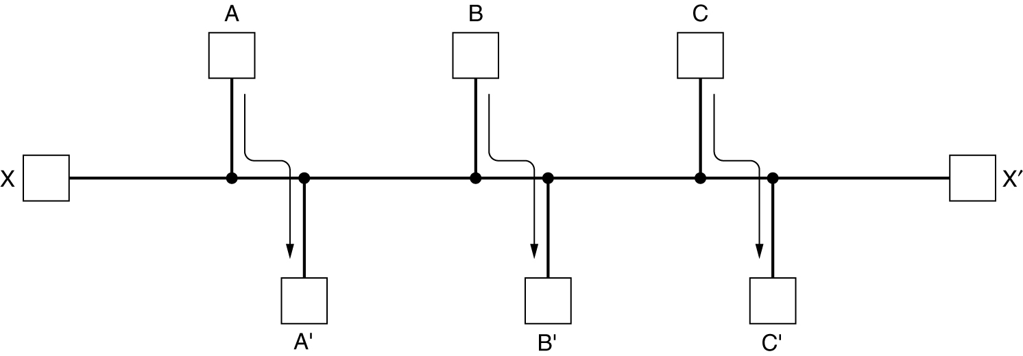
Routing —— Introduction(2)
Conflict between fairness and optimality.

Slide 11
Routing —— Introduction(3)
Classification of the routing algorithms
  Nonadaptive algorithms: 非自适应的路由算法：静态
    do not base their routing decisions on measurements or estimates of the current traffic and topology ,
    sometimes called static routing
  Adaptive algorithms : 自适应的路由算法，动态
    change their routing decisions to reflect changes in the topology, and usually the traffic as well.
    sometimes called dynamic routing

Slide 12
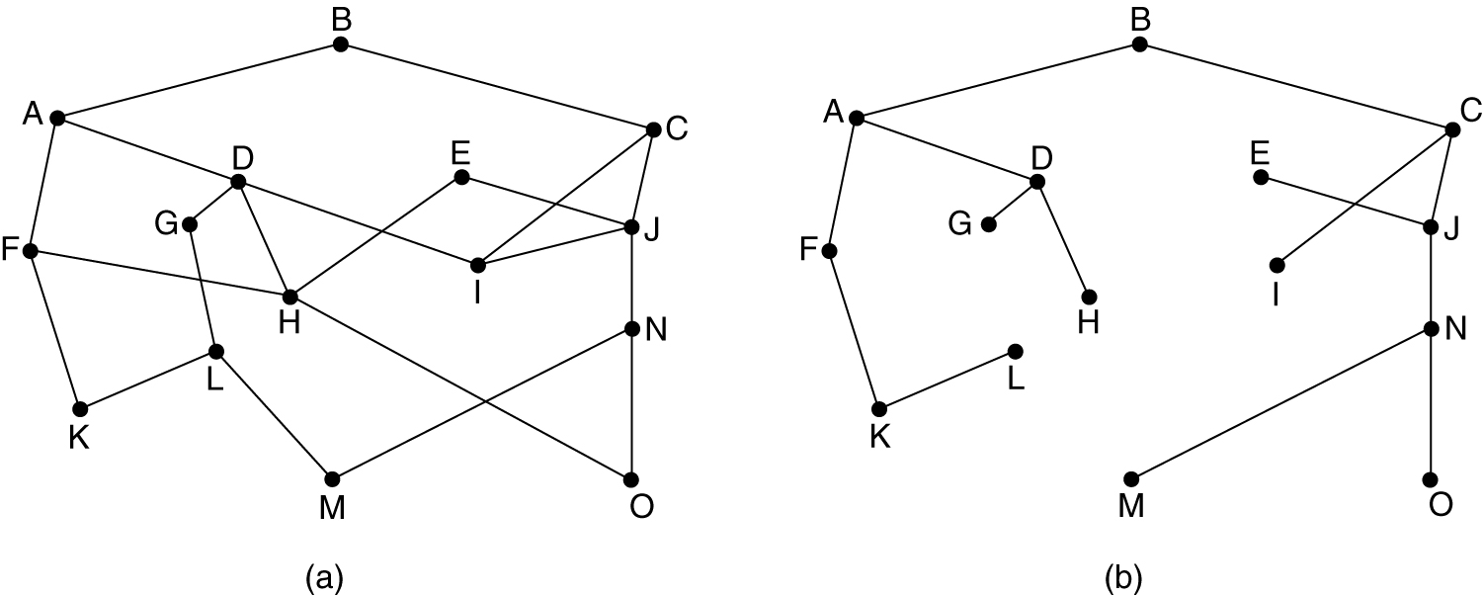
The Optimality Principle
(a) A subnet. (b) A sink tree for router B.
Optimality Principle：If router J is on the optimal path from router I to router K, then the optimal path from J to K also falls along the same route.

Slide 13
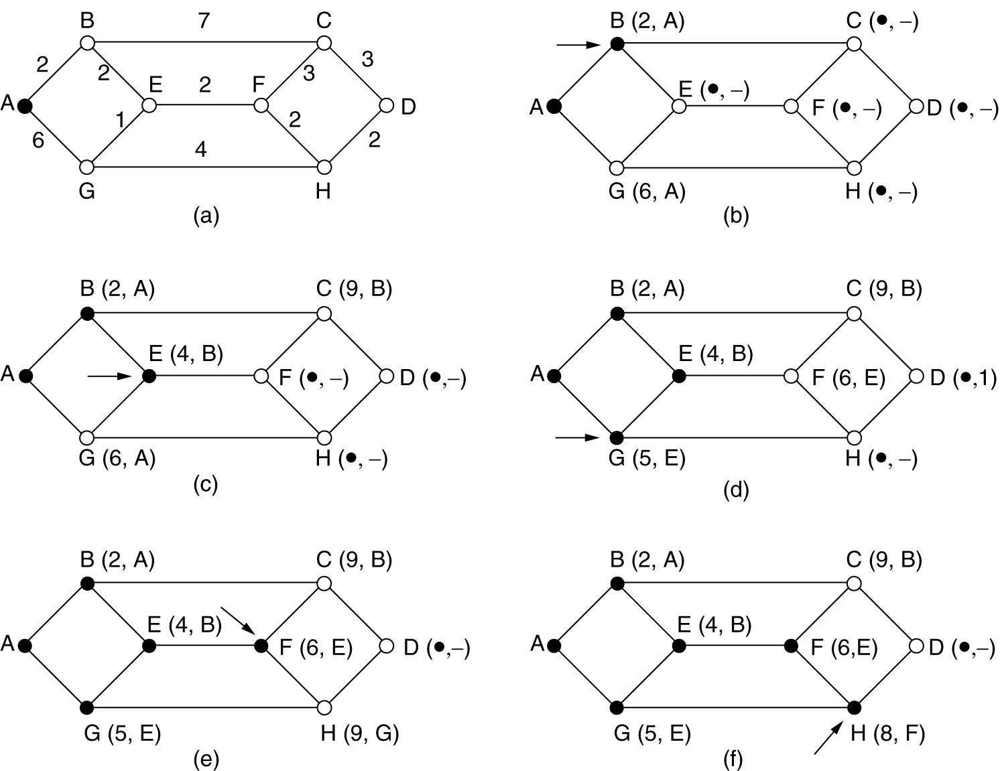
Shortest Path Routing
The first 5 steps used in computing the shortest path from A to D.
The arrows indicate the working node.
Notes:
最短路径：需要知道到达目的地址

Slide 14
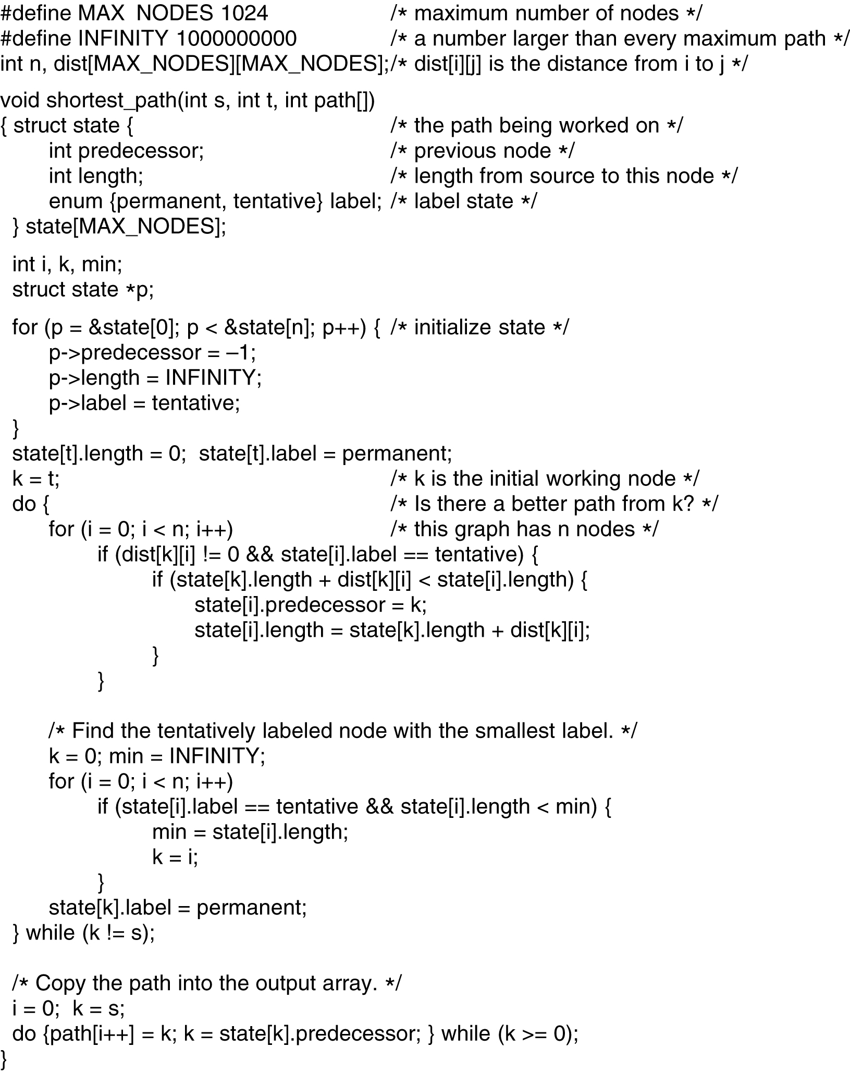
5-8 top
Dijkstra's algorithm to compute the shortest path through a graph.

Slide 15
5-8 bottom
Dijkstra's algorithm to compute the shortest path through a graph.

Slide 16
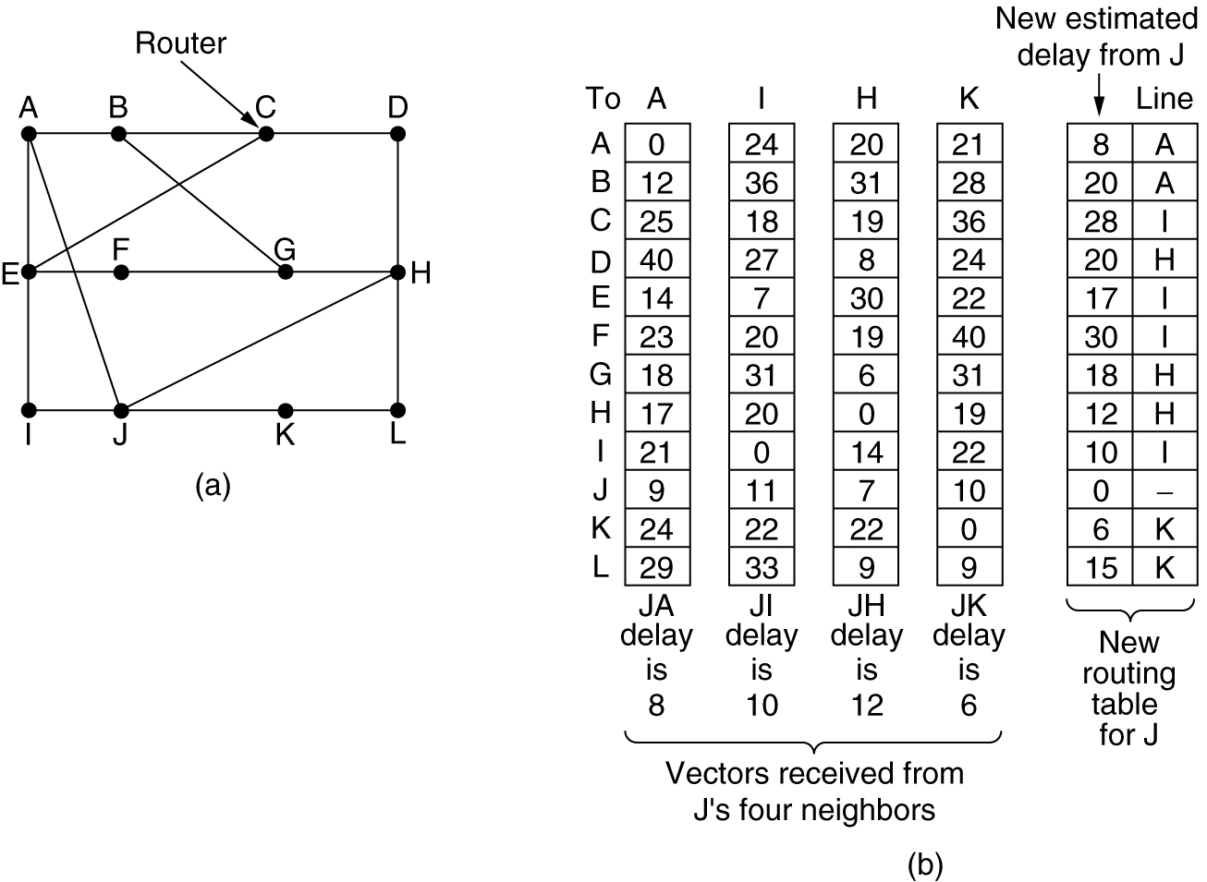
Distance Vector Routing
Suppose that J has measured or estimated its delay to its neighbors, A, I, H, and K as 8, 10, 12, and 6 msec, respectively
A subnet.
Input from A, I, H, K, and the new routing table for J.
Notes:
距离矢量的路由算法：只知道开销，不知道路程经过
不需要全网的网络拓扑结构
如A：如果从A发送数据给B，开销是12。列是发送方，行是接收方。A自己给A发，开销是0
第G行表示如果J发给A、A再发给G，开销是多少，由此计算出到各个路由器的开销路径
每个路由器启动后，给各个路由器发送探测消息，进而得知对应开销，后路由器会将该开销的信息转发给相连的路由器，周边路由器一次广播。
J列是对应左图的J，表示J是如何形成路由表的

Slide 17
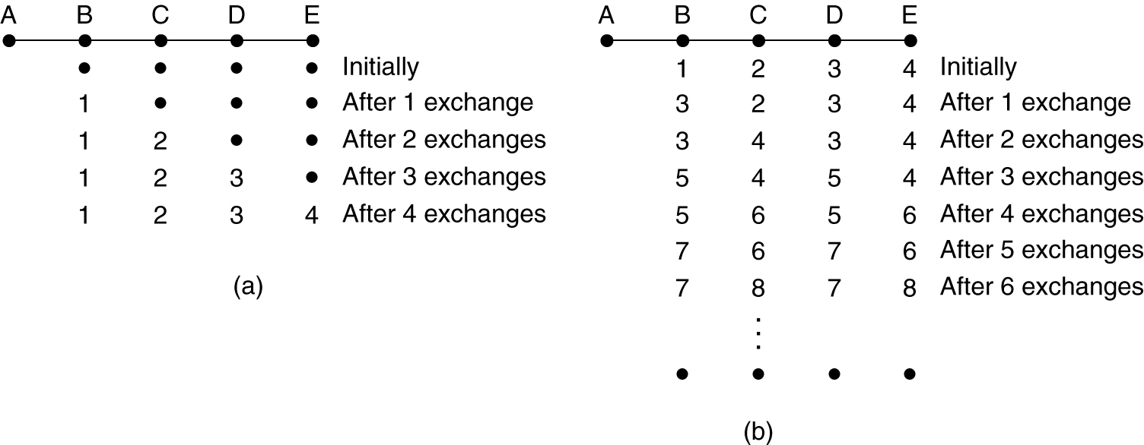
Distance Vector Routing (2)
The count-to-infinity problem.

Slide 18
Link State Routing
Each router must do the following:
  Discover its neighbors and learn their network addresses:
    When a router is booted, its first sends a special HELLO packet on each point-to-point line to learn who its neighbors are. The router on the other end is expected to send back a reply telling who it is.
  Measure the delay or cost to each of its neighbors
  Construct a packet telling all it has just learned
  Send this packet to all other routers.
  Compute the shortest path to every other router
In effect, the complete topology and all delays are experimentally measured and distributed to every router. Then Dijkstra’s algorithm can be run to find the shortest path to every other router.
Notes:
链路状态路由算法：
每个收到这个探测消息的路由器都要回送罅隙；这样可以使一个路由器知道周边有多少个路由器
每个路由器的网卡后面都接着一个子网，子网里都是计算机，计算机都有自己的IP地址，由此构成一个IP地址的前缀
一台路由器在启动的时候会发送链路状态消息给周边的路由器，周边的路由器收到信息后，会把收到的消息（子网的前缀就是链路状态消息）从自己的所有路由器端口广播，广播的路由器的周边的路由器也会知道第一个路由器的IP主机地址前缀，依次广播，结果大家都知道了 = =
链路状态消息包括连接的子网的IP地址前缀和周边的路由器，这个算法就是将link state广播，进而大家都知道

Slide 19
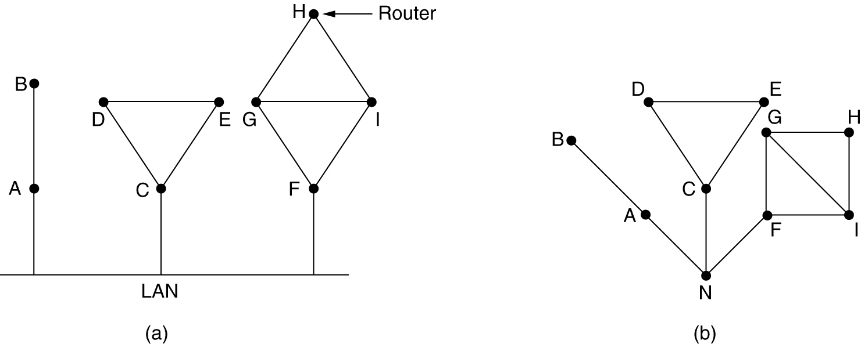
Learning about the Neighbors
(a) Nine routers and a LAN. (b) A graph model of (a).

Slide 20
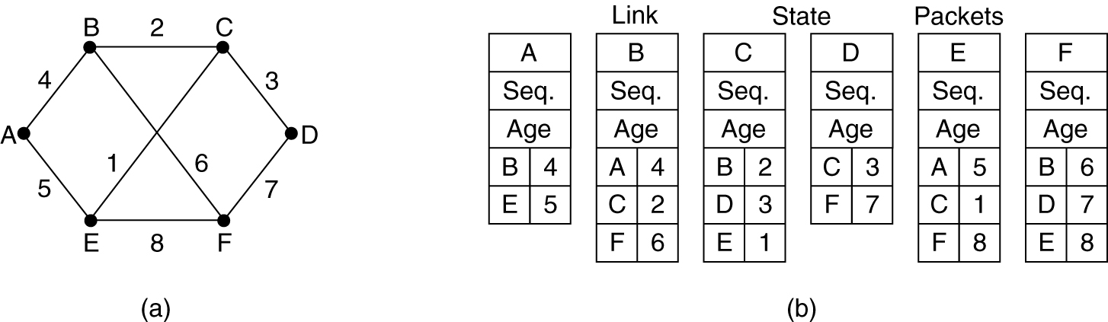
Building Link State Packets
(a) A subnet. (b) The link state packets for this subnet.

Slide 21
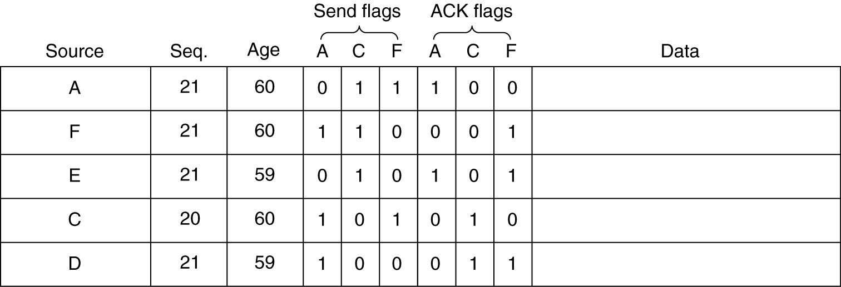
Distributing the Link State Packets
The packet buffer for router B in the previous slide (Fig. 5-13).

Slide 22
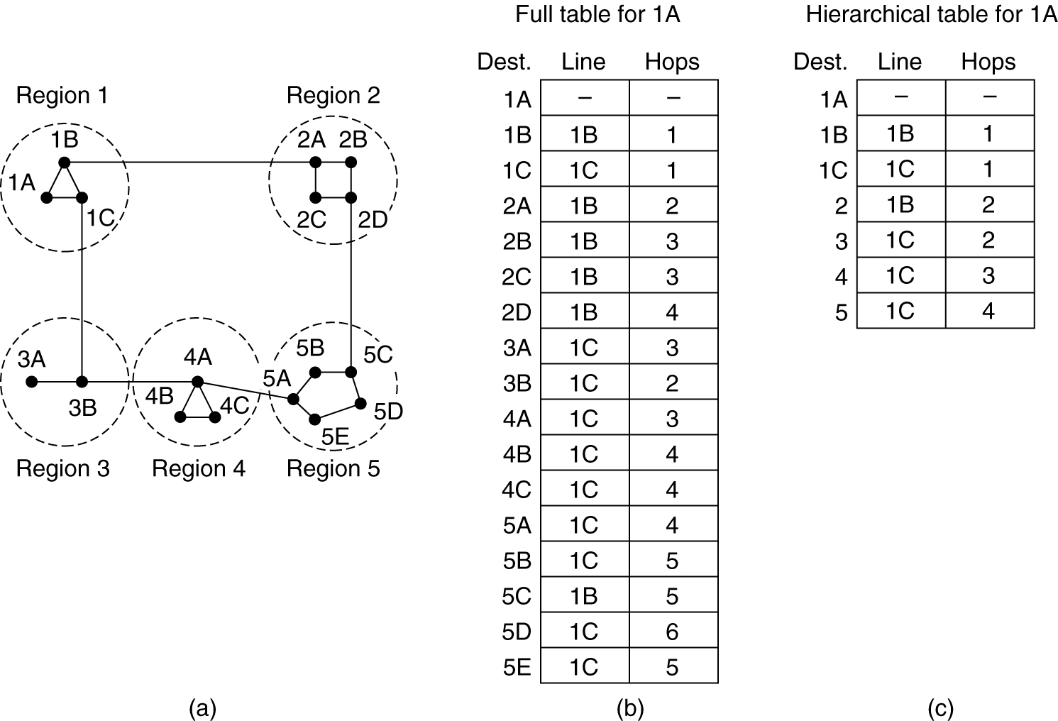
Hierarchical Routing

Slide 23
Broadcast Routing
Various method for broadcast routing:
  the source simply send a distinct packet to each destination;
  Flooding is another obvious candidate;
  multidestination routing: each packet contains either a list of destinations or a bit map indicating the desired destinations
  spanning tree:
    makes explicit use of the sink tree for the router initiating the broadcast - or any other convenient spanning tree for that matter
    If each router knows which of its lines belong to the spanning tree, it can copy an incoming broadcast packet onto all the spanning tree lines except the one it arrived on
  reverse path forwarding:

Slide 24
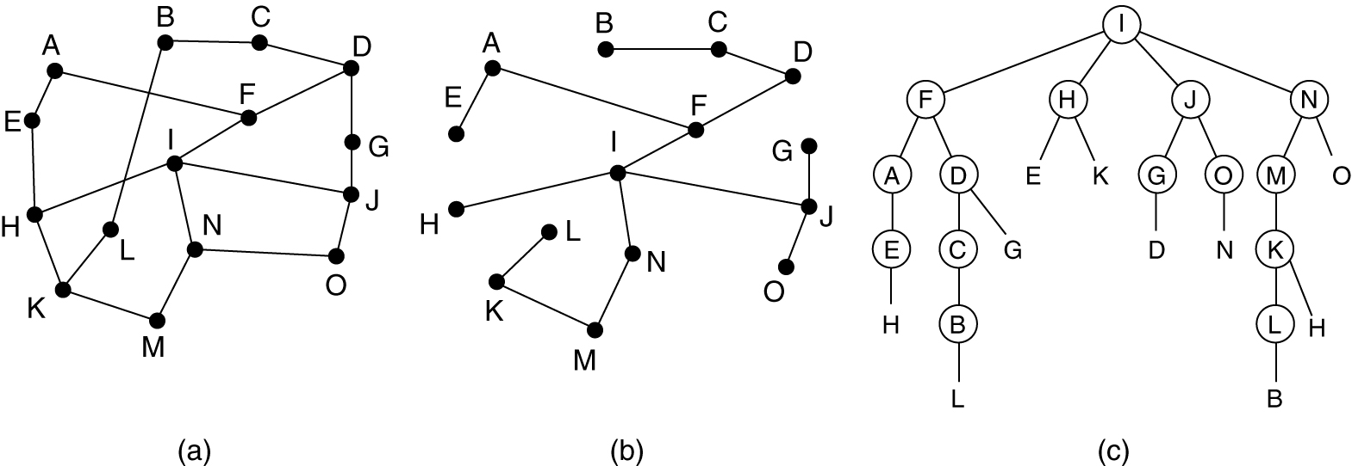
Broadcast Routing
Reverse path forwarding. (a) A subnet. (b) a Sink tree. (c) The tree built by reverse path forwarding.

Slide 25
Multicast Routing
Multicasting：sending a message to such a group
Multicast Routing: routing algorithm for multicasting
Multicasting requires group management:
  Some way is needed to create and destroy groups, and to allow processes to join and leave groups. How these tasks are accomplished is not of concern to the routing algorithm.
  What is of concern is that when a process joins a group, it informs its host of this fact. It is important that routers know which of their hosts belong to which groups.
To do multicast routing, each router computes a spanning tree covering all other routers.

Slide 26
Summary
IP Forwarding
Routing
  Why routing, how to do that
The Optimality Principle, Shortest Path Routing
Adaptive Routing (Dynamic Routing)
  Why
  Distance Vector Routing, Link State Routing
  Hierarchical Routing
  Broadcast Routing, Multicast Routing

